Slide 1
Electric Charge
Electric charge is a basic property of matter
Positive and Negative
Each having an absolute value of 1.6 x 10⁻¹⁹ Coulombs
Like signed charges repel each other
Unlike signed charges attract each other

Slide 2
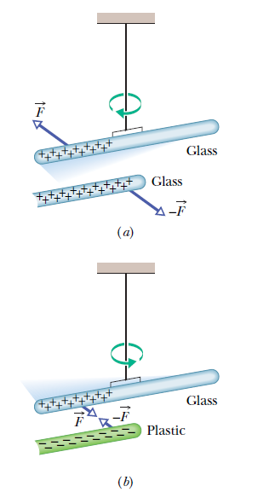

Slide 3
Electric Charge
In an atom, a positively charged nucleus is surrounded by electrons
The protons (+) in the nucleus attract the electrons (-), while the electrons repel each other

Slide 4
Atoms
All electrons are identical, with the same mass and same quantity of charge
The nucleus is composed of protons (all of which are also identical) and neutrons (neutral)
Atoms usually have as many electrons as protons, so the atom has a zero net charge

Slide 5
Ions
If a particle is removed from the atom, it becomes an ion
Positive Ion: Has lost one or more electrons and has a net positive charge
Negative Ion: Has gained one or more electrons and has a net negative charge

Slide 6
Removal of Electrons
The inner electrons are bound very tightly to the atom
The outermost electrons of many atoms are bound loosely and can be easily dislodged

Slide 7
Conductors
Materials which allow electric charge to flow freely
Metals are good conductors because their outer electrons are not bound tightly

Slide 8
Insulators
Materials which do not allow electric charge to flow freely (i.e. glass, rubber)

Slide 9
Semiconductor
Materials that can be made to behave as either a conductor or an insulator of electricity, i.e. germanium, silicon
Superconductor: Material that has infinite conductivity at low temperatures so that charge flows through it without resistance

Slide 10
Conservation of Charge
No case of the creation or destruction of net electric charge has ever been found
Electrons are always transferred in whole – they cannot be divided into fractions of electrons

Slide 11

Conservation of Charge
Example 1:
Radioactive decay of nuclei, in which a nucleus transforms into (becomes) a different type of nucleus. A uranium-238 nucleus transforms into a thorium- 234 nucleus by emitting an alpha particle. An alpha particle has the same makeup as a helium-4 nucleus, it has the symbol ⁴He. Here the net charge is 92➔90+2.
Notes:
The hypothesis of conservation of charge has stood up under close examination, both for large-scale charged bodies and for atoms, nuclei, and elementary particles.

Slide 12

Conservation of Charge
Example 2:
An electron e⁻ (charge -e) and its antiparticle, the positron e⁺ (charge +e), undergo an annihilation process, transforming into two gamma rays (high-energy light):. Here the net charge is 0➔0.

Slide 13
Conservation of Charge
Example 3:
A gamma ray (in a certain environment) transforms into an electron and a positron. Here the net charge is again 0➔0.

Slide 14
Electrostatics
Electric charges at rest (static electricity)
Involves electric charges, forces between them, and their behavior in materials

Slide 15
Electric Forces
Arise from the particles in atoms
Alone: Billions and billions of times as strong as the force of gravity
In Pairs: Cancel each other out and have no noticeable effect

Slide 16
Coulomb’s Law
The force between two charges depends on the magnitude of the charges and the distance between them
F = k
q₁q₂
d ²

Slide 17
Coulomb’s Law
q₁q₂
F = k
d ²
Units of charge = Coulomb (C)
k is a proportionality constant called the Coulomb constant
k ≈ 9,000,000,000 ^{N·m2} or 9·10⁹ ^{N·m2}
_{C}2
_{C}2

Slide 18
Useful Numbers
Charge of an Electron | q_{e} = -1.6 · 10⁻¹⁹ C
Charge of a Proton | q_{p} = +1.6 · 10⁻¹⁹ C

Slide 19
Sample Problem
Two electrons are a meter apart.
What is the force between them?
What direction is it in?

Slide 20
Sample Problem
d = 1m
q_{p} = -1.6*10⁻¹⁹C q_{e} = -1.6*10⁻¹⁹C
q₁q₂
F = k
d ²
(-1.6*10⁻¹⁹C)* (-1.6*10⁻¹⁹C)
F = (9*10⁹N*m²/C²)
(1 m)²
F = 2.3*10⁻²⁸N

Slide 21
Sample Problem
Two electrons are two meters apart.
What is the force between them?
What direction is it in?

Slide 22
Coulomb’s Law
The force between the two particles falls off as 1/d²
q₁q₂
F = k
d ²

Slide 23
Bell Ringer
Two electrons are two centrimeters apart.
What is the force between them?
What direction is it in?

Slide 24
Charging
Items may be charged by friction
Electrons are moved from one object to another by being scraped away
Items may be charged by contact
Electrons are moved without being scraped off

